Slide 1


Evaluate-STIG
Presented By: Daniel Ireland

Slide 2

Evaluate-STIG
PowerShell scripts to automatically document STIG compliance
Reduces manual effort from hours/days to minutes.
Automatically determines which supported STIGs are applicable to the asset.
Supports multiple output formats (CKL, CKLB, CSV, XCCDF, etc.)
More automated coverage for STIG checks than traditional process of SCAP benchmark + manual review and supports STIGs where no benchmarks are available.
Can scan both local and remote machines.
Only validates compliance – does not make system changes or attempt to configure to STIG requirement.
Single code set that supports both Windows and Linux.

Slide 3












Some of Our Users

Slide 4
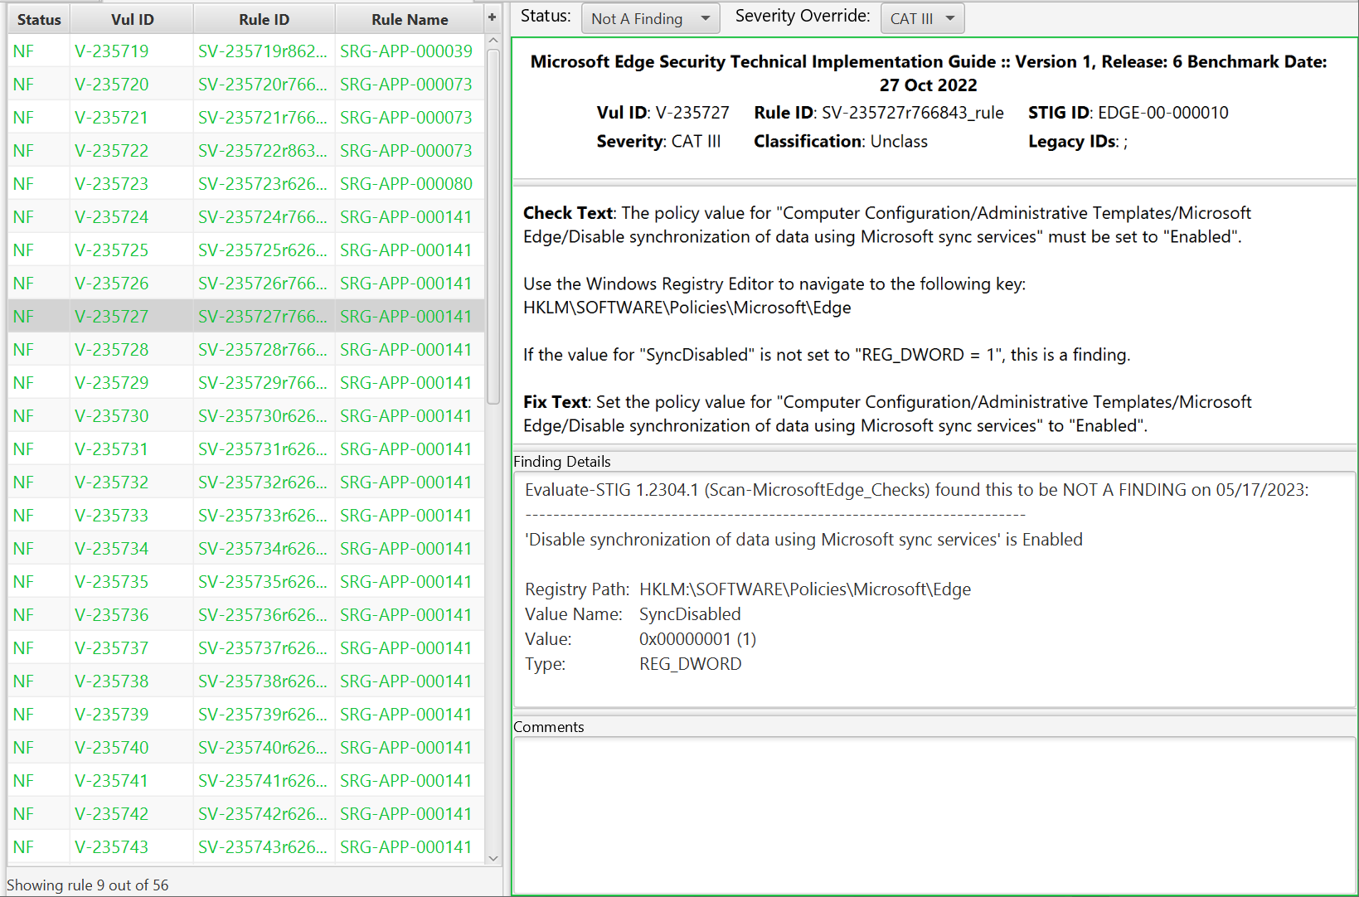
Checklist Documentation
‘Check Text’ requirement is evaluated
Configuration documented into ‘Finding Details’
Optional Answer File text placed in ‘Comments’

Slide 5
Process Comparison
Traditional (SCAP + Manual)
Analyst:
Determines which STIGs are applicable to asset
Imports STIGs into STIG Viewer and creates blank checklists
Installs SCAP benchmarks (if available) and runs scan
Opens each checklist and imports applicable XCCDF file (if available)
Manually reviews and documents Not Reviewed and Open items for each STIG checklist.
Evaluate-STIG
Automation:
Automatically determines which STIGs are applicable to asset
Can document compliance directly into CKL/CKLB for each required STIG
Injects user-defined Comments from answer file if applicable
Analyst:
Finalizes checklists by documenting Open findings or completing any remaining Not Reviewed items.

Slide 6
Completion Comparison

Slide 7
Real World Comparison
RDT&E Machine : 18 Checklists Required…
* No DISA SCAP support
Adobe Reader DC Continuous Track | Microsoft Office 365
Google Chrome | Microsoft OneDrive *
Microsoft .NET Framework 4 | Mozilla Firefox
Microsoft Defender Antivirus | Windows 11
Microsoft Edge | Windows Firewall
Microsoft Internet Explorer 11
 | No Automation | DISA SCAP | Evaluate-STIG
Remaining Not Reviewed (NR) Checks | 827 | 148 | 13
Labor Hours to Complete (4.5 mins per NR) ⁺ | 62.03 | 11.10 | 0.98
Labor Cost to Complete ($126 per hour) ⁺ | $7,815.78 | $1,398.60 | $123.48
Total Labor Hour Avoidance (4.5 mins per NR) ⁺⁺ | 0 | 50.93 | 61.05
Quarterly Cost Avoidance ($126 per hour) ⁺⁺ | $0.00 | $6,417.18 | $7,692.30
+ Smaller is better ++ Larger is better

Slide 8
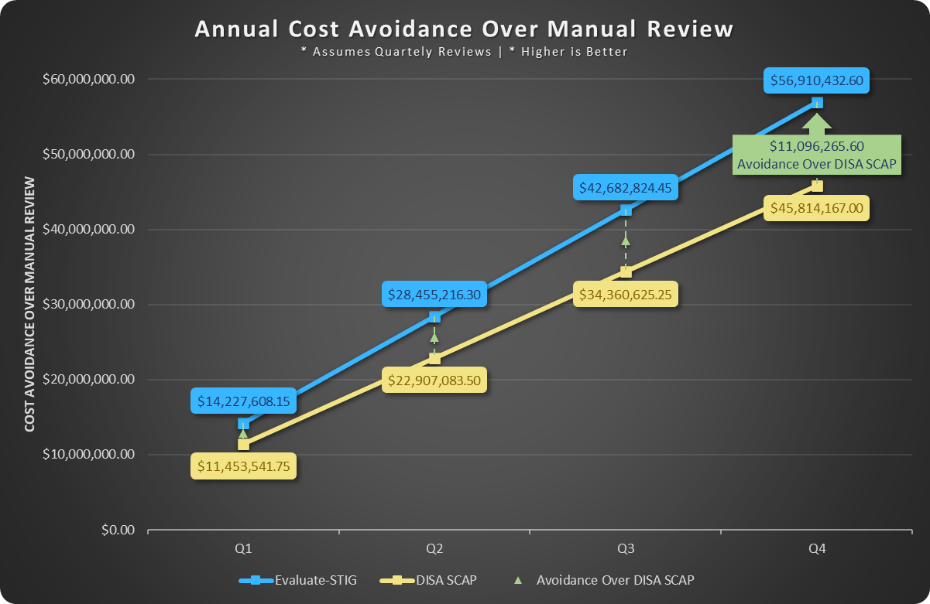
Cost Avoidance
NSWC Crane’s Windows assets connected to its unclassified RDT&E network. Approximately 2057 assets with varying configurations.

Slide 9
User Profile Selection
Almost all user-based STIG checks direct the inspection of the HKEY_CURRENT_USER registry hive (the currently logged on user).
Scanning every user profile (NTUSER.DAT) on a system can lead to mass false positives due to how Windows applies user policy settings.
Evaluate-STIG simulates an administrator / auditor in-person session where the HKCU settings are inspected.
Evaluate-STIG looks at multiple data points before selecting which user profile to use:
Profile that most recently applied GPO is preferred. This is ideal.
If no profiles have processed GPO, then the profile most recently loaded or NTUSER.DAT last modified. Risk of mass false positives.
If no user has ever logged on, then “.DEFAULT” user profile. Most likely mass false positives will occur.

Slide 10
System Requirements
Supported Operating Systems
Amazon Linux 2023 | Oracle Linux 7 | Windows 7 * | Windows Server 2019
Canonical Ubuntu 16.04 | Oracle Linux 8 | Windows 10 | Windows Server 2022
Canonical Ubuntu 18.04 | Oracle Linux 9 | Windows 11 | Windows Server 2025
Canonical Ubuntu 20.04 | Red Hat Enterprise Linux 7 | Windows Server 2008 R2 *
Canonical Ubuntu 22.04 | Red Hat Enterprise Linux 8 | Windows Server 2012 / R2 *
Canonical Ubuntu 24.04 | Red Hat Enterprise Linux 9 | Windows Server 2016
* Requires Windows Management Framework 5.1
Prerequisites
Windows | PowerShell 5.1 | PowerShell 7.3 or greater (PowerShell 6 is not supported) Compatible PowerShell Execution Policy (depends on code signing certificate trust) Recommend adding included DOD-issued code signing certificate to the following store: Local Machine\Trusted Publishers For MS SQL: Administrator level permission to both the operating system and SQL instance/database
Linux | Libraries libicu, lshw, dmidecode, and bc must be installed When running from: PowerShell direct: PowerShell 7.3 or greater must be installed (note RHEL7 only supports PowerShell 7.3) Bash: Supported PowerShell archive (7.3 or greater) renamed to powershell.tar.gz located within the Evaluate-STIG folder. Use --DownloadPS or perform this manually. If using fapolicyd for application whitelisting, pwsh and libhostfxr.so must be allowed.
NOTE: Prerequisites folder contains support script to help in meeting the above requirements.

Slide 11
Evaluate-STIG Options
Scan Options
Option | Description
-ScanType <“Unclassified” or ”Classified”> | Use to instruct Evaluate-STIG the classification of the asset. Valid ScanTypes are "Unclassified" and "Classified". If not specified, default will be "Unclassified".
-Marking <String> | Use to optionally set Marking in CKL/CKLB and on header/footer of files generated by Evaluate-STIG. Example use is "CUI"/"Confidential"/"Secret"/"Top Secret" but accepts any marking string.
-TargetComments <String> | Use to optionally set the Target Comments field in CKL|CKLB outputs.
-VulnTimeout <Int16> | Maximum time in minutes to allow a singular Group ID check to run. Default is 15.
-FileSearchTimeout <Int16> | Maximum time in minutes (1-1440) for file type search run during prescan. Default is 240. This is for checks requiring that all hard disks be searched for specific file types (e.g. .pfx).
-AnswerKey <key name> | Use to instruct Evaluate-STIG which Answer Key to use for determining if a comment from an answer file should be applied. Answer Keys are per Group ID and user-defined within the answer file. If not specified, default Answer Key will be "DEFAULT".
-AFPath <local or UNC path> | Path to Answer Files. If not specified, defaults to $PsScriptRoot\AnswerFiles.
-Output <CKL, CombinedCKLB, Summary> | Specify output type(s). Use comma separation for multiple. If not specified, output will be returned to console.
-JSON | Output Console Object in JSON Format using OutputPayload Options. JSON Objects are based on Group ID. Requires -Output Console.
-OutputPayload <Title, Version, GroupID> | Specify which fields to output when outputing to CSV, JSON, or Splunk. Order of fields will be retained from command line. For multiple, separate with commas. Default is all fields. Requires -Output CSV|CombinedCSV|Splunk or -JSON.
-OutputPath <local or UNC path> | Sets the directory path for Evaluate-STIG to save output to (excluding STIGManager and Splunk). Requires -Output. May be a local or UNC path. If not specified, default path will be C:\Users\Public\Public Documents or \opt\.If using -OutputPath with -ComputerName, ensure the source computer's account has write access to the path in -OutputPath.
-PreviousToKeep <Int32> | Number of previous scan results to retain. Default is 1. Requires -Output.
-AllowDeprecated | Enable scanning of STIGs that are no longer available on cyber.mil (deprecated). By default, deprecated STIGs will not be scanned.
-AllowSeverityOverride | Enables setting the Security Override and Justification fields in the checklist when the STIG contains verbiage that a specific criterion changes the severity of the check. Check your organization’s policy before using.
-AllowIntegrityViolations | Ignores Evaluate-STIG file integrity validation failures and allows the scan to continue.

Slide 12
Evaluate-STIG Options
Scan Options - continued
Option | Description
-SelectSTIG <Shortname>, <Shortname> | Specify which STIG(s) to scan. Use Tab or CTRL+SPACE to properly select STIG(s) by its short name. For deprecated STIGs, must call -AllowDeprecated first. For multiple STIGs, separate with commas. Cannot be specified with -ExcludeSTIG.
-SelectVuln <Vuln ID>, <Vuln ID> | Specify which Group ID(s) to scan (V-#####). For multiple, separate with commas. Can only be used with -SelectSTIG.
-ExcludeVuln <Vuln ID>, <Vuln ID> | Specify which Group ID(s) to exclude from the scan (V-#####). For multiple, separate with commas. Can only be used with -SelectSTIG.
-ExcludeSTIG <Shortname>, <Shortname> | Specify which STIG(s) to exclude from the scan. Use Tab or CTRL+SPACE to properly exclude STIG(s) by its short name. For multiple STIGs, separate with commas. Cannot be specified with -SelectSTIG.
-ForceSTIG <Shortname>, <Shortname> | Ignore detection of STIG applicability and forcefully run a scan of selected STIG(s). Use Tab or CTRL+SPACE to properly select STIG(s) by its short name. For multiple STIGs, separate with commas. *WARNING* Evaluate-STIG results are not guaranteed with this option. Use at own risk. *WARNING*
-SelectInstance <String>,<String> | Specify which instance(s) to scan for STIGs where instance is within context. For multiple instances, separate with commas. Cannot be specified with -ExcludeInstance.
-ExcludeInstance <String>,<String> | Specify which instance(s) to exclude from the scan for STIGs where instance is within context. For multiple instances, separate with commas. Cannot be specified with -SelectInstance.
-SelectDatabase <String>,<String> | Specify which database(s) to scan for STIGs where database is within context. For multiple databases, separate with commas. Cannot be specified with -ExcludeDatabase.
-ExcludeDatabase <String>,<String> | Specify which database(s) to exclude from the scan for STIGs where database is within context. For multiple databases, separate with commas. Cannot be specified with -SelectDatabase.
-SelectSite <String>,<String> | Specify which site(s) to scan for STIGs where site is within context. For multiple sites, separate with commas. Cannot be specified with -ExcludeSite.
-ExcludeSite <String>,<String> | Specify which site(s) to exclude from the scan for STIGs where site is within context. For multiple sites, separate with commas. Cannot be specified with -SelectSite.
-ApplyTattoo | Creates tattoo under HKLM:\SOFTWARE\Evaluate-STIG (Windows) or /etc/Evaluate-STIG (Linux)

Slide 13
Evaluate-STIG Options
Remote and Cisco Options
Option | Description
-ComputerName <IP>, <name>, <list>, <array> | Scan remote computer(s). Win to Win or Win to Linux only. For multiple, separate with commas. Can be IP, name, .txt file, array object, or a combination. “Localhost” and “127.0.0.1” also valid.
-CiscoConfig <Path>, <Path> | Scan Cisco show tech-support output file(s). <Path> may be an individual file or a folder of show tech-support files. Use comma separation for multi.
-ThrottleLimit <int> | Max concurrent remote scan connections or Cisco show tech-support files. Default is 10.
-SelectDeviceType <"Router"|"Switch"> | Specify a device type for IOS, IOS-XE Catalyst 9k series, and IOS-XE ISR device specific Cisco configs. Use comma separation for multiple.
-AltCredential | Prompt for alternate credential to be use for remote scans.
Utility Options
Option | Description
-SMCollection <String> | Instruct Evaluate-STIG which STIGManager Collection to upload results.
-SMPassphrase <String> | Passphrase to decrypt private key if encrypted .key is used for authentication to a STIGManager instance.
-SplunkHECName <String> | Name of Splunk HTTP Event Collection (HEC) to upload results.
-ListSupportedProducts | Lists all products that Evaluate-STIG currently supports.
-ListApplicableProducts | Lists all Evaluate-STIG supported STIGs that are applicable to the asset.
-Version | Display the version of Evaluate-STIG and the running path.
-Update | Downloads updated Evaluate-STIG code from SPORK.
-LocalSource <String> | Updates from a local path containing the extracted Evaluate-STIG content.
-Proxy <String> | Specify proxy to use for -Update

Slide 14
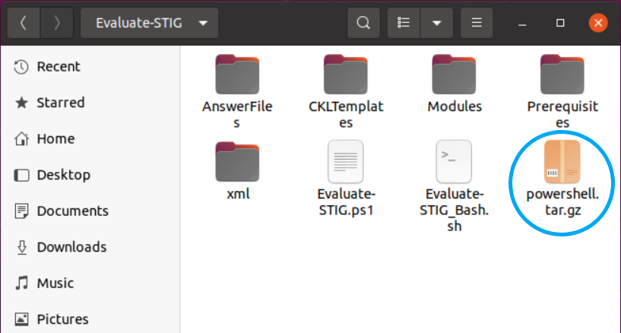
Linux Scans
Using the included Evaluate-STIG_Bash.sh removes the requirement to “install” PowerShell on Linux machines when performing a local scan.
If performing a remote Linux scan from a Windows host, PowerShell is required to be installed on the Linux system.
Performing Local Scan Using Evaluate-STIG_Bash.sh:
Use --DownloadPS to download PowerShell archive to the Evaluate-STIG folder. This will be temporarily extracted to conduct the scan. For disconnected systems, download the linux-x64.tar.gz archive from the link below using a connected system, rename to powershell.tar.gz, and place in the Evaluate-STIG directory. https://github.com/PowerShell/PowerShell/releases/latest
Use -h to display the help.
Execute your scan.
sudo bash Evaluate-STIG_Bash.sh --DownloadPS
bash Evaluate-STIG_Bash.sh -h
sudo bash Evaluate-STIG_Bash.sh <Scan Options>

Slide 15
Remote Scans
Remote systems must resolve in DNS as all connections are made to the fully qualified domain name (FQDN) of the asset.
On Windows machines, PowerShell remoting must be enabled.
Can be done via Group Policy or the Enable-PSRemoting command.
Windows >> Linux
Requires PowerShell 7.x installed on both the host and remote machines.
Requires SSH configuration on both endpoints:
Linux >> Linux
Recommend our Ansible playbook, Evaluate-STIG.yml, available in the optional Auxiliary Files download.
Linux >> Windows
Not supported.
Administrative rights on host and remote machines.
https://learn.microsoft.com/en-us/powershell/scripting/learn/remoting/ssh-remoting-in-powershell-core

Slide 16
Windows to Linux Remote Scan Checklist
Install PowerShell 7 on the Windows host and Linux remote machines:
Windows https://learn.microsoft.com/en-us/powershell/scripting/install/installing-powershell-on-windows?view=powershell-7.4
Linux https://learn.microsoft.com/en-us/powershell/scripting/install/installing-powershell-on-linux?view=powershell-7.4
Install and configure the SSH service on the Windows host: https://learn.microsoft.com/en-us/powershell/scripting/security/remoting/ssh-remoting-in-powershell?view=powershell-7.4#install-the-ssh-service-on-a-windows-computer
Install and configure the SSH service on each Linux remote: https://learn.microsoft.com/en-us/powershell/scripting/security/remoting/ssh-remoting-in-powershell?view=powershell-7.4#install-the-ssh-service-on-an-ubuntu-linux-computer
Test PowerShell connectivity from the Windows host using PowerShell 7:
Run your remote scan and specify a credential that has sudo privilege.
Enter-PSSession –HostName <RemoteHostName> –UserName <UserWithSUDO>

Slide 17
Install and Configure SSH - Windows
Install and configure the SSH service on the Windows host:
Install OpenSSH
Start the OpenSSH SSH Server service (creates the config file)
Update C:\ProgramData\ssh\sshd_config:
Uncomment “PasswordAuthentication yes” line
Add “Subsystem powershell c:/progra~1/powershell/7/pwsh.exe -sshs –nologo” line
Restart OpenSSH SSH Server service
Get-WindowsCapability –Online | Where-Object Name –match OpenSSH | ForEach-Object {Add-WindowsCapability –Online –Name $_ .Name}
Start-Service sshd
Restart-Service sshd

Slide 18
Install and Configure SSH - Linux
Install and configure the SSH service on each Linux remote:
Install OpenSSH
Update /etc/ssh/sshd_config:
Uncomment “PasswordAuthentication yes” line
Add “Subsystem powershell /usr/bin/pwsh -sshs –nologo” line
Restart OpenSSH SSH Server service
sudo apt install openssh-client
sudo apt install openssh-server
sudo systemctl restart sshd.service

Slide 19
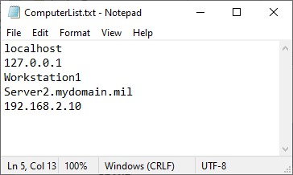
Remote Scanning Notes
Requires administrator access on remote systems.
Copies Evaluate-STIG and Answer File content to remote system and the remote scans itself.
-OutputPath is from host computer perspective. If not specified, results copied to C:\Users\Public\Documents\STIG_Compliance on host computer. Example: Results would be copied to E:\ drive on host computer; not on “Workstation1”.
-ComputerName can be single entry, multiple with comma separation, .txt file, array object, or combination:
Text file (.txt) list of computers should have one computer per line.
Hosts must resolve in DNS. All connections are to FQDN (except localhost).
-AltCredential to specify a credential to be used with remote connections. Evaluate-STIG will attempt this first, then try launching user; essentially allowing for 2 different credentials per scan.
Defaults to 10 concurrent connections. Can be changed with -ThrottleLimit.
.\Evaluate-STIG.ps1 –ComputerName Workstation1 –Output CKL –OutputPath E:\STIGResults
.\Evaluate-STIG.ps1 –ComputerName Workstation1
.\Evaluate-STIG.ps1 –ComputerName C:\ComputersList.txt, Server1.mydomain.mil
.\Evaluate-STIG.ps1 –ComputerName localhost, C:\ComputersList.txt, $ArrayOfComputers

Slide 20
Answer Files
XML files to inject user-defined comment into the checklist’s Comments field and optionally set Status
When to use:
Providing standardized verbiage for policy type checks (e.g. backups are stored offsite)
Automating checks where further validation is required (e.g. comparing list of approved Administrator group members to asset’s configuration)
Adding justification and mitigation statements for known Open items
Default path is .\Evaluate-STIG\AnswerFiles\ or specify an alternate path with –AFPath
PowerShell skillset strongly recommended

Slide 21
Answer File Development
Review
ISSO and SME review results for checks requiring
answers.
SME executes a rescan using answer file to ensure expectation is met.
Verify
Define
XML
ISSO and SME collaborate on verbiage (Comment) and any criteria (ValidationCode).
Build
SME writes / updates answer file based on
defined requirements.

Slide 22
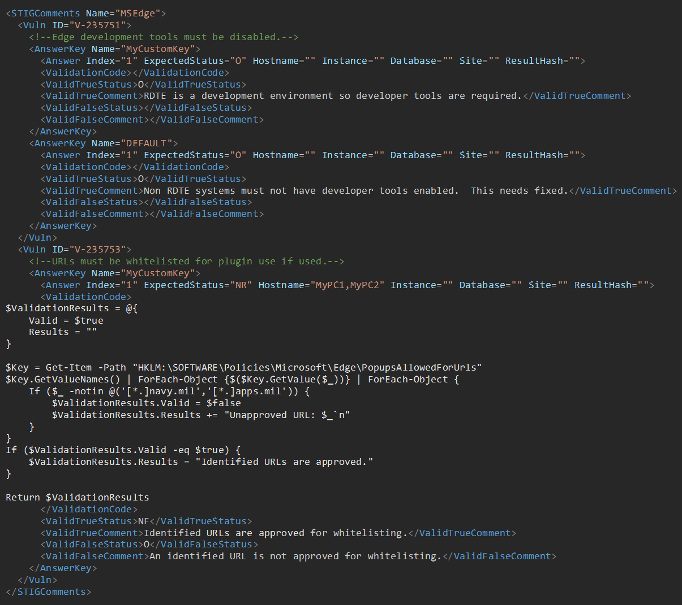
Example Answer File

Slide 23
Example Answer File
<STIGComments>
Name: ShortName as it appears in -ListSupportedProducts or -SelectSTIG (for unsupported STIGs) output. Evaluate-STIG will automatically use this answer file for the STIG if a valid match is found.
<Vuln>
ID: Group ID or Rule ID from the STIG. Multiple Vuln ID sections may be configured in a single answer file but each Vuln ID section must be unique within the answer file. For example V-12345 cannot be configured multiple times within the same answer file.
<AnswerKey>
Name: Name to use with -AnswerKey. Multiple answer key sections may be configured within each Vuln ID section. May be any text. “DEFAULT” may be used to apply the answer to any asset where other keys do not match.
> Note: Refer to “Selection of Winning Answer” in user guide regarding multiple answer keys.
> Note: If multiple answer files are found for a STIG, the most recently modified (LastWriteTime) answer file will be used.

Slide 24
Example Answer File
<Answer>
Index: Index for the answer. May be any text. Multiple <Answer> elements may be configured provided the Index is unique.
ExpectedStatus: Status that Evaluate-STIG originally returned. Retrieve from Finding Details. Must be proper format.
Hostname: (Optional) Hostname(s) the answer applies to. Comma separated for multiple.
Instance: (Optional) Instance(s) the answer applies to. Retrieve from Finding Details. Comma separated for multiple.
Database: (Optional) Databases(s) the answer applies to. Retrieve from Finding Details. Comma separated for multiple.
Site: (Optional) Sites(s) the answer applies to. Retrieve from Finding Details. Comma separated for multiple.
ResultHash: (Optional) Result hash(es) the answer applies to. Retrieve from Finding Details. Comma separated for multiple.
> Note: Configured optional attributes (if in context of STIG) will require a match for the answer to apply.
> Note: Refer to “Selection of Winning Answer” in user guide regarding Index weighting.

Slide 25
Example Answer File
<ValidationCode>: PowerShell code to be executed by Evaluate-STIG before applying answer. Code should output “true/false” or a hashtable object with “Valid” (boolean) and “Results” (string) values. If hashtable, content in “Results” will be written to Comments in addition to the answer file comment. If this element is blank then “true” is assumed.
<ValidTrueStatus>: Status to set the check to when ValidationCode is “true”. If no status change is desired, leave blank or configure to be same as ExpectedStatus.
<ValidTrueComment>: Text to be added to the Comments field when ValidationCode is “true”.
<ValidFalseStatus>: Status to set the check to when ValidationCode is NOT “true”. If no status change is desired, leave blank or configure to be same as ExpectedStatus.
<ValidFalseComment>: Text to be added to the Comments field when ValidationCode is NOT “true”.
* Reminder: If ValidationCode is blank, then “true” is assumed and ValidTrueStatus/ValidTrueComment will be used.

Slide 26
Answer File Processing

Slide 27
Answer File Notes
File name does not matter but file extension must be “.xml”
Answer file automatically associated to STIG when <STIGComments Name> matches STIG ShortName from -ListSupportedProducts or -SelectSTIG (for unsupported STIGs).
<Vuln ID> may be the Group ID or Rule ID from the STIG.
Each <AnswerKey> element may have multiple <Answer> elements provided the Index for each is unique.
<ValidationCode> is not required. If empty, <ValidTrueStatus> and <ValidTrueComment> will always be applied.
Comment text will always be applied to the Comments field in the checklist. It will also be duplicated to Finding Details if empty.
DO
Point -AFPath to a folder and NOT an answer file. Evaluate-STIG automatically selects the Answer File.
Use a single answer file for each STIG. Multiple <Vuln ID> and <AnswerKey Name> is supported in an answer file.
DON’T
Have multiple answer files for the same STIG in AFPath. This is not supported. In the event multiple answer files for a STIG are detected, Evaluate-STIG will only use the most recently modified file.
Specify the same <Vuln ID> more than once within an answer file. This is not supported.

Slide 28
Versioning and Updates
Evaluate-STIG is versioned as <Major>.<YYMM>.<Release> (e.g. 1.2301.1)
YYMM is the year and month from the current STIG quarter per DISA’s schedule.
Release will be incremented as needed for updates during a STIG cycle to address out-of-cycle STIG releases, bug fixes, etc..
DISA’s posted STIG release schedule (https://www.cyber.mil/stigs/quarterly-release-schedule-and-summary):
Q1 | End of January | [1.YY01.0]
Q2 | End of April | [1.YY04.0]
Q3 | End of July | [1.YY07.0]
Q4 | End of October | [1.YY10.0]
For currently supported STIGs, Evaluate-STIG is updated quarterly after the STIG Library Compilation .zip is posted to cyber.mil (approx. 2 weeks after). Additional updates may also be posted as needed to address bug fixes or other changes.
New STIG support is added based on demand and resourcing.

Slide 29
Official Approvals
DADMS – ID 133953
Army – Assess Only (eMASS ID 4546)
NAVAIR – “All RMF authorization boundaries that fall under the NAVAIRSYSCOM Functional Authorizing Official”
NMCI – CCSW (eMASS ID 13969) and UCSW (eMASS ID 14441)
Navy RMF Focus Tool

Slide 30
Supported STIGs (106 currently)
Active Directory Domain * | Cisco IOS XE Switch NDM * | Microsoft Office System 2016 * | Microsoft Word 2013 *
Active Directory Forest * | Cisco IOS XE Switch RTR * | Microsoft OneDrive * | Microsoft Word 2016 *
Adobe Acrobat Pro XI * | Citrix Virtual Apps and Desktop 7.x Workspace App * | Microsoft OneNote 2013 * | MongoDB Enterprise Advanced 3.x *
Adobe Acrobat Professional DC Classic Track * | Google Chrome Current Windows | Microsoft OneNote 2016 * | Mozilla Firefox
Adobe Acrobat Professional DC Continuous Track * | JBoss Enterprise Application Platform 6.3 * | Microsoft Outlook 2013 * | MS SharePoint Designer 2013 *
Adobe Acrobat Reader DC Classic Track * | McAfee VirusScan 8.8 Local Client * | Microsoft Outlook 2016 * | MS SQL Server 2014 Database *
Adobe Acrobat Reader DC Continuous Track | Microsoft .NET Framework 4 | Microsoft PowerPoint 2013 * | MS SQL Server 2014 Instance *
Amazon Linux 2023 * | Microsoft Access 2013 * | Microsoft PowerPoint 2016 * | MS SQL Server 2016 Database *
Apache Server 2.4 UNIX Server * | Microsoft Access 2016 * | Microsoft Project 2013 * | MS SQL Server 2016 Instance *
Apache Server 2.4 UNIX Site * | Microsoft Defender Antivirus | Microsoft Project 2016 * | Oracle Java JRE 8 for Unix *
Apache Server 2.4 Windows Server * | Microsoft Edge | Microsoft Publisher 2013 * | Oracle Java JRE 8 for Windows *
Apache Server 2.4 Windows Site * | Microsoft Excel 2013 * | Microsoft Publisher 2016 * | Oracle Linux 7
Apache Tomcat Application Server 9 * | Microsoft Excel 2016 * | Microsoft SharePoint 2013 * | Oracle Linux 8
ArcGIS for Server 10.3 * | Microsoft Exchange 2016 Edge Transport Server * | Microsoft Skype for Business 2016 * | Oracle Linux 9 *
Canonical Ubuntu 16.04 LTS * | Microsoft Exchange 2016 Mailbox Server * | Microsoft SQL Server 2022 Database * | PostgreSQL 9.x *
Canonical Ubuntu 18.04 LTS | Microsoft Exchange 2019 Edge Server * | Microsoft SQL Server 2022 Instance * | Rancher Government Solutions RKE2 *
Canonical Ubuntu 20.04 LTS | Microsoft Exchange 2019 Mailbox Server * | Microsoft Visio 2013 * | Red Hat Enterprise Linux 7
Canonical Ubuntu 22.04 LTS | Microsoft Groove 2013 * | Microsoft Visio 2016 * | Red Hat Enterprise Linux 8
Canonical Ubuntu 24.04 LTS | Microsoft IIS 10.0 Server * | Microsoft Windows 10 | Red Hat Enterprise Linux 9
Cisco IOS Router NDM * | Microsoft IIS 10.0 Site * | Microsoft Windows 11 | Trellix ENS 10.x Local Client *+
Cisco IOS Router RTR * | Microsoft IIS 8.5 Server * | Microsoft Windows Defender Firewall | VMware Horizon 7.13 Agent *
Cisco IOS Switch L2S * | Microsoft IIS 8.5 Site * | Microsoft Windows Server 2012/2012 R2 DC * | VMware Horizon 7.13 Client *
Cisco IOS Switch NDM * | Microsoft InfoPath 2013 * | Microsoft Windows Server 2012/2012 R2 MS * | VMware Horizon 7.13 Connection Server *
Cisco IOS Switch RTR * | Microsoft Internet Explorer 11 | Microsoft Windows Server 2016 | Windows 7 *
Cisco IOS XE Router NDM | Microsoft Lync 2013 * | Microsoft Windows Server 2019 | Windows Server 2008 R2 Member Server *
Cisco IOS XE Router RTR | Microsoft Office 365 ProPlus | Microsoft Windows Server 2022
Cisco IOS XE Switch L2S * | Microsoft Office System 2013 * | Microsoft Windows Server Domain Name System *
* STIGs with no DISA SCAP support
+ Separate Download not included with Evaluate-STIG distributable

Slide 31




FIN!
Questions?
Connect!
Download
NIPR
https://spork.navsea.navy.mil/nswc-crane-division/evaluate-stig/-/releases · (Unclassified Content Only)
https://intelshare.intelink.gov/sites/NAVSEA-RMF · (Unclassified and CUI Content)
SIPR
https://intelshare.intelink.sgov.gov/sites/NAVSEA-RMF · (Unclassified and CUI Content)
Fusion Chat
https://chat.navsea.navy.mil/channel/evaluate-stig
Teams (Navy Flank Speed)
NAVSEA_RMF
EMAIL:
eval-stig_spt@us.navy.mil
Get Release Notifications:
Navy Personnel : Sign up Here
Non-Navy : Send an email to eval-stig_spt@us.navy.mil and we’ll get you added.

Slide 32
Agenda – Intro/Basic Usage
About Evaluate-STIG
System Requirements and Prerequisites
Evaluate-STIG Options
Demo - Basic Usage
Release Cadence
Q&A

Slide 33
Agenda –Linux & Remote Scans
Linux Scanning
Demo
Remote Scanning
Remote Scanning Process
Evaluate-STIG Options
Windows to Windows
Demo
Windows to Linux
Demo
Q&A

Slide 34
Agenda – Answer Files
What Are They?
Development Cycle and Anatomy
Process Flow
Demo – Answer Files
Q&A

Slide 35
Demo
Live Demo

